Slide 1

1000 Movies Data
EDA
by Aditya AVS

Slide 2
Story
Given a set of 1000 movies from 2006-2016, need to understand the trends and get insights into the same.

Slide 3
Data in depth
Rank | int64
Title | object
Genre | object
Description | object
Director | object
Actors | object
Year | int64
Runtime (Minutes) | int64
Rating | float64
Votes | int64
Revenue (Millions) | float64
Metascore | float64

Slide 4
Problem Statement
Being a movie buff, I have selected this data set to provide some insights into the movie This dataset is a collection of details about the 1000 movies released in between 2006 - 2016. My aim is to derive some insights about the movies that broke all barriers and created records (both ways :) )
The goal is to see which movies were enjoyed by the audience, critics and which were not.
Also, to analyse the trends over the period of 10 years.

Slide 5
Analysis
I tried to correlate the various parameters and understand the relationship between different parameters of the data set.
Derived the insights by understanding the trends.

Slide 6
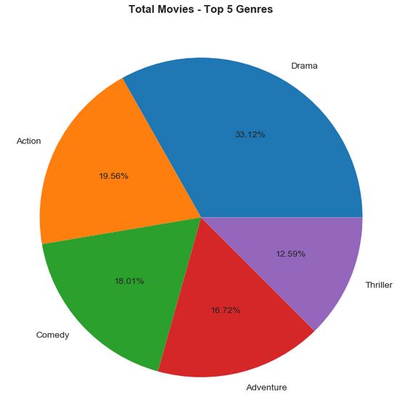
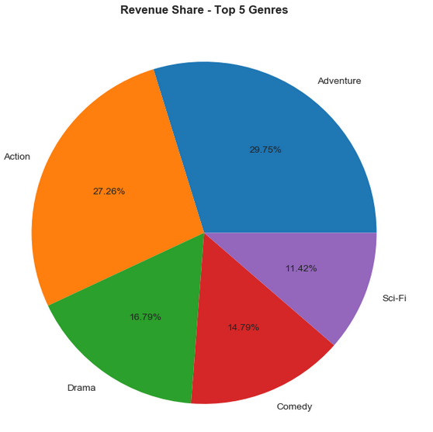
Top 5 movie genres

Slide 7
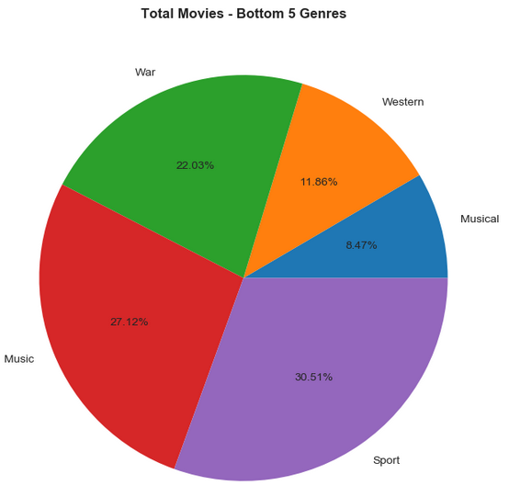
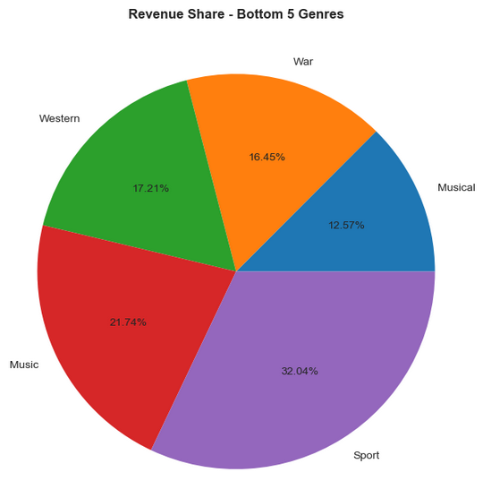
Bottom 5 movie genres

Slide 8
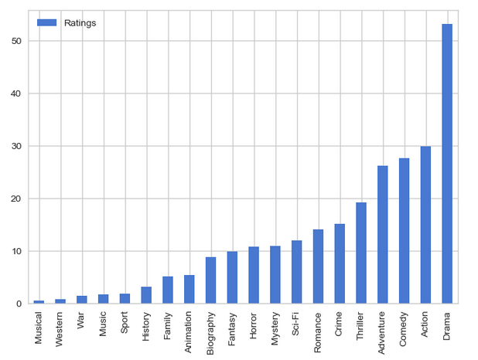
Ratings across various Genres

Slide 9
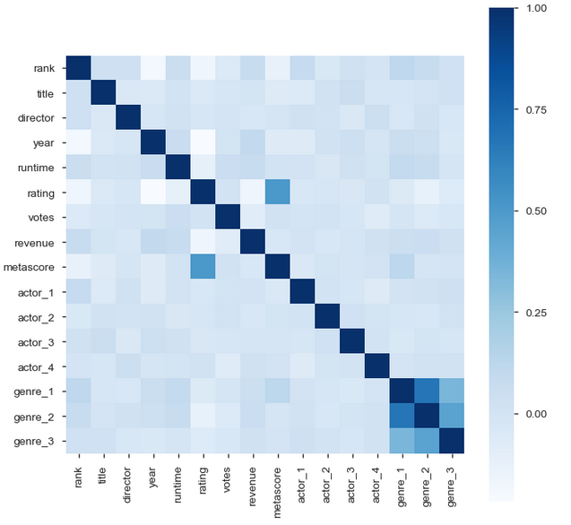
Correlation among various parameters

Slide 10
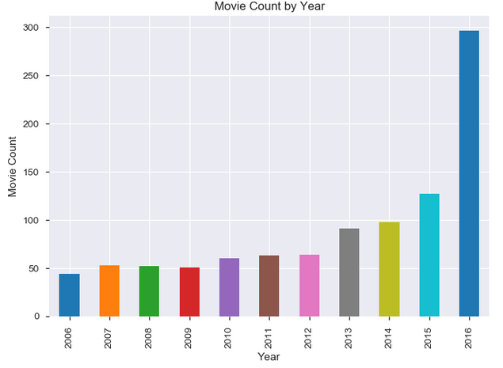
Movie count year on year

Slide 11
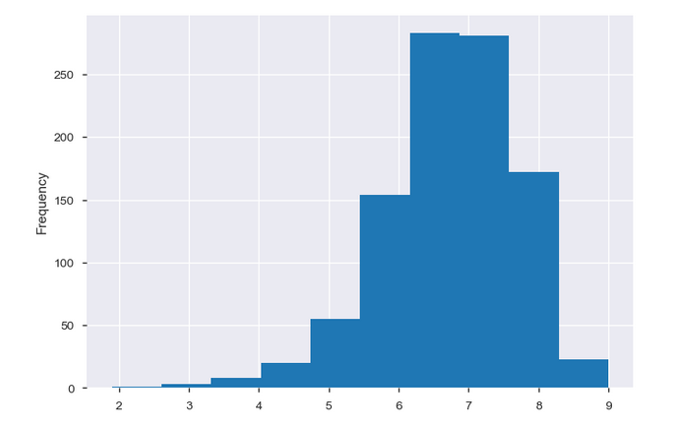
Ratings of movies

Slide 12
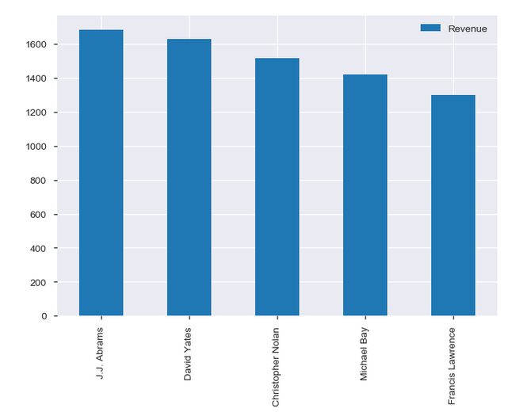
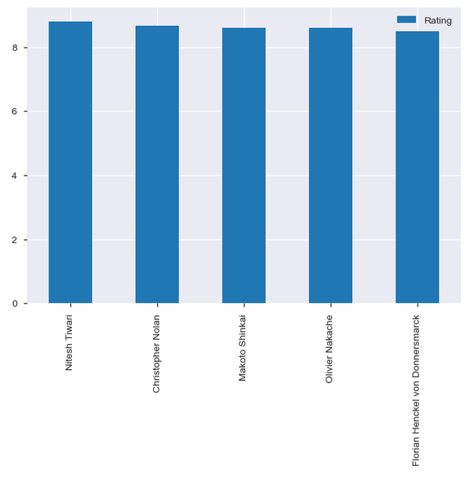
Directors

Slide 13
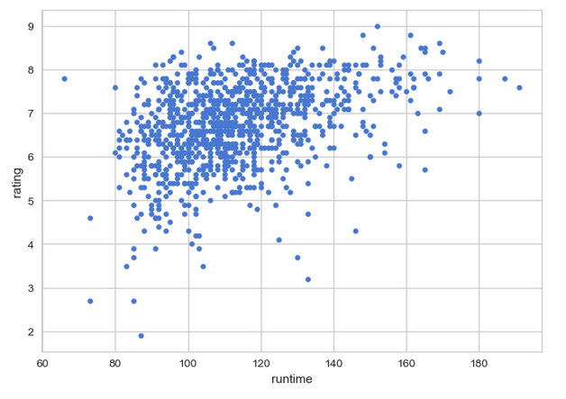
Runtime vs. Ratings

Slide 14
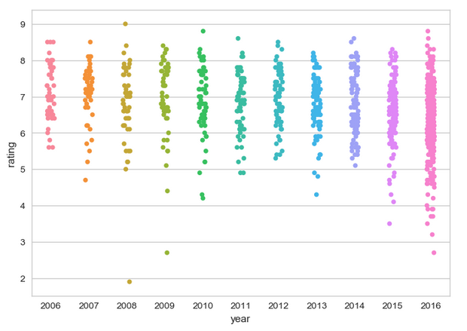
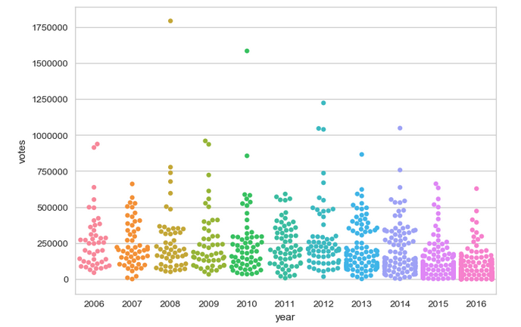
Ratings and Votes year on year

Slide 15
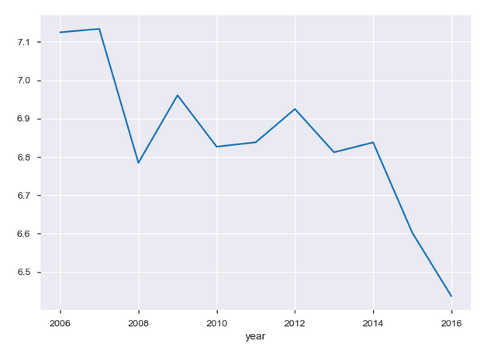
Average Rating trend

Slide 16
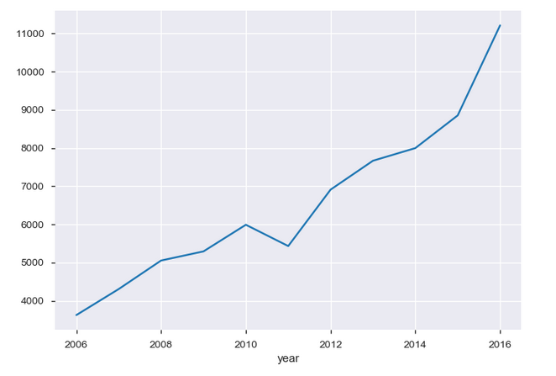
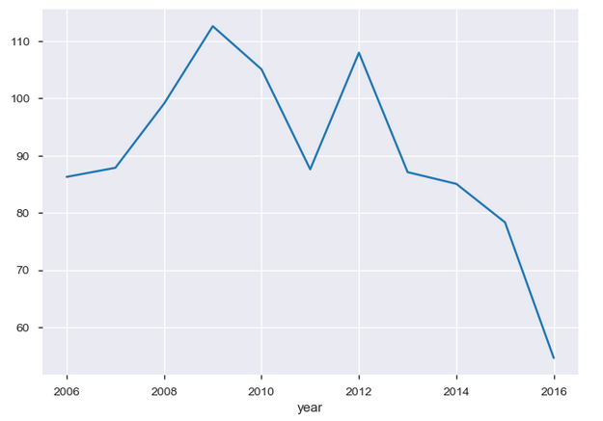
Revenue trend
Total Revenue
Average Revenue

Slide 17
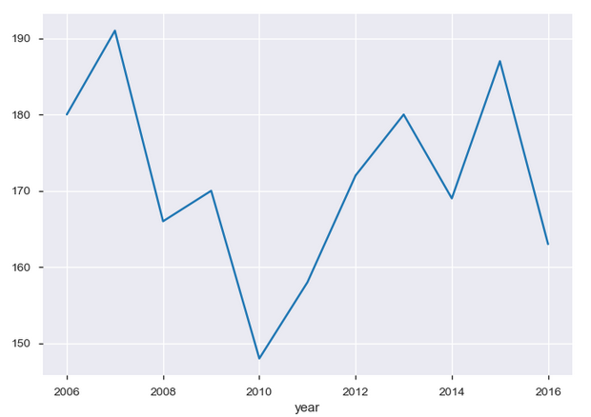
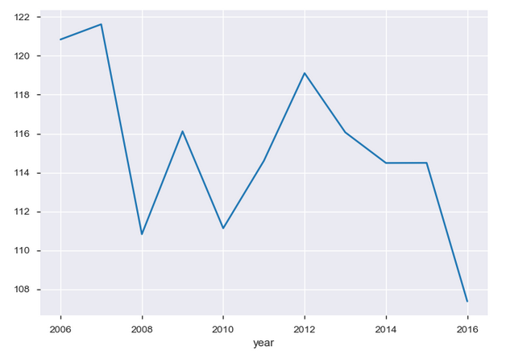
Runtime trend
Max Runtime
Average Runtime

Slide 18
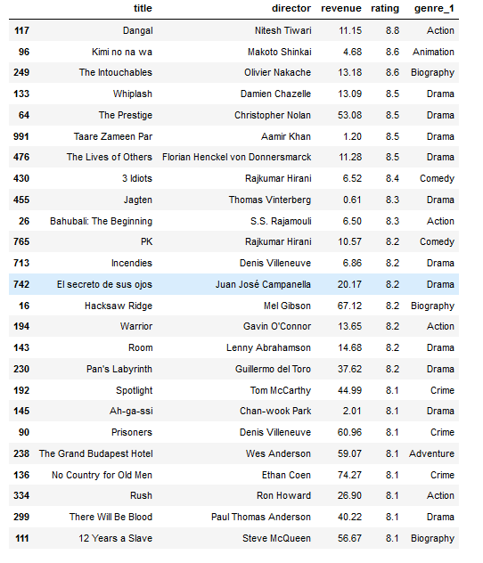
Highly rated – low revenue

Slide 19
Conclusion
The data set gives us insights about the 1000 movies released in between 2006 - 2016.
The movies are spread across 20 different Genres. (Section 4.4)
Adventure and Action movies are having a good market at the box office followed by Drama, Comedy and Sci-Fi movies.
But the highest number of movies were made in the Drama genre followed by action and comedy.
The least favorited genres are Musical, Western and War.
As the number of movies made in these genres are less, their collections are also correspondingly low.
Drama movies are rated much higher compared to any other Genres.
Movies taken in Action genre were successful in all the three categories - rating, votes and revenue. (Overall)

Slide 20
Conclusion
The number of movies almost doubled from 2015 to 2016. Till 2013, the number of movies made was around 50 but the trend started changing from 2013. (Section 5.1)
Rating and metascore are highly corelated whereas Revenue and Rating have low correlation. (Section 5.2)
Majority of the movies have rating between 6 - 8 (Average good movies)(Section 5.4)
Of the top 50 highly rated movies, 25 (50%) of them reported very low revenues. Mostly in the drama genre. (Section 6.1) Another interesting fact about these movies is that they contain the Indian movies.
Majority of the films that have good rating (>6) have a runtime between 80 - 120 minutes. (Section 5.10)
Trend over the years (From section 6.2)
The average rating is declining over the years but as the number of movies are more in number the total rating per year is increasing.
The average revenue is also on the declining probably owing to the drama movies but the overall box office collections are increasing year on year.
The average runtime of movies are on the declining trend (from 120 min to 106 min)

Slide 21
Conclusion
More people are going to the cinemas after 2013 than before and they are preferring short movies packed with adventure, action rather than drama.
The average revenue per movie is decreasing though the overall collections are on the rise.
High revenue collection movies have high ratings but the vice-versa is not true. That is highly rated or crtically acclaimed movies failed to collect money.

